Slide 1
JESSE OWENS
(1913.-1980.)

Slide 2
James Cleveland "Jesse" Owens
Jesse was an American track and field athlete and four-time Olympic gold medalist.
Jesse was born in September 12, 1913. in Oakvile,Alabama.
Jesse died in March 31, 1980. in Tuscon,Arizona.
Owens is perhaps the greatest and most famous athlete in track and field history.
At the 1936 Summer Olympics in Berlin, Germany, Owens won international fame with four gold medals: 100 meters 200 meters, long jump, and 4x100 meter relay.
He crushed Hitler's myth of Aryan supremacy.

Slide 3
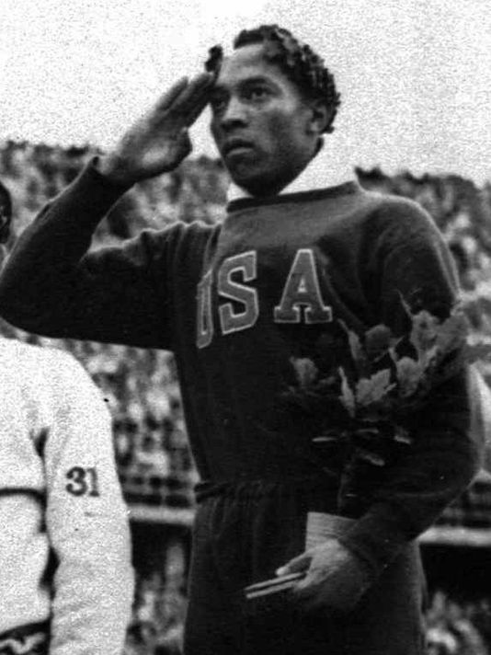
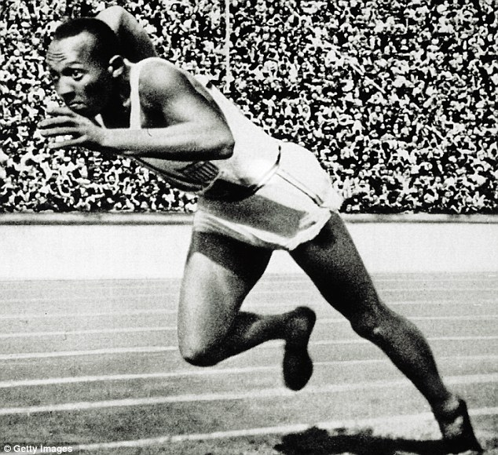

Slide 4
Early life of Jesse
Jesse was the youngest of the ten children.
He was nine when his family moved to Cleveland, Ohio for better opportunities.
When his teacher asked him whts his name he said “J.C.”,becouse of his Southern accent she thougt he said “Jesse” he was known as Jesse Owens for rest of his life.
As a boy, Owens took different jobs in his spare time. He worked in a shoe repair shop while his father and older brother worked at a steel mill. During this period he realizedd that he had a passion for running.

Slide 5
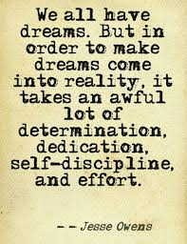
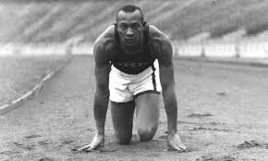

Slide 6
Berlin Olympics
1936. Summer games took place in Berlin, where A. Hitler wanted to show superiority of German athletes.
Just before the competitions, Owens was visited in the Olympic village by Adi Dassler, the founder of the Adidas athletic shoe company. He persuaded Owens to use his shoes. This was the first sponsorship for a male African-American athlete.
During the olympics games in 1936. Owens triumphed by winning the fourth gold medal in the 4x100-metre relay race and proved that Hitlers racist theories were wrong .

Slide 7
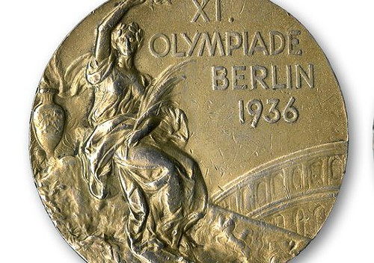
Jesses gold medal from the Berlin Olympics games 1936.

Slide 8
Personal life and death
Owens and Minnie Ruth Solomon met at Fairmount Junior High School in Cleveland .They dated steadily through high school. Ruth gave birth to their first daughter, Gloria, in 1932.They married in 1935 and they had a two more daughters.
He died in Tucson, Arizona, on March 31, 1980, with his wife and other family members at his bedside.

Slide 9
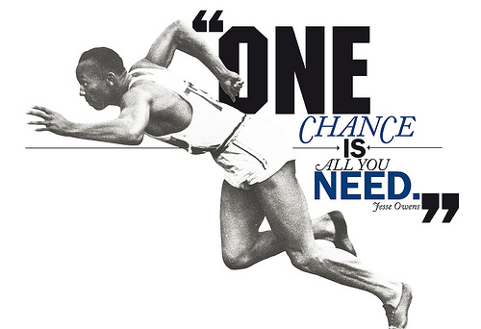
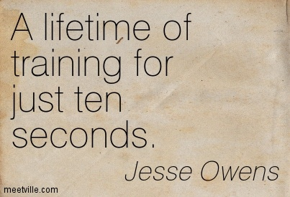
JESSE OWEND QUOTES

Slide 10
THE END
Thanks for watching.
Marko Plazanić 8.B

