Slide 1
ADIDAS ENERGY BOOST

Slide 2
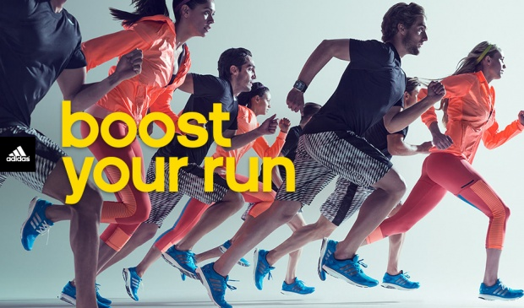
Boost provides more energy, combining soft comfort with responsive energy.
The latest Adidas sneakers are extremely comfortable, because it was made without stitches elastic meshwork Techfit material, which perfectly adapts to your foot like a sock.

Slide 3
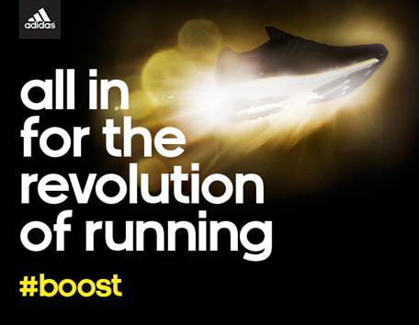
At temperatures from -20 to +40 degrees Celsius Boost has proven to three times more resistant than the Eva foam which is used in most of sneakers.
Energy Boost contains additional Adidas technology for stability and durability.

Slide 4
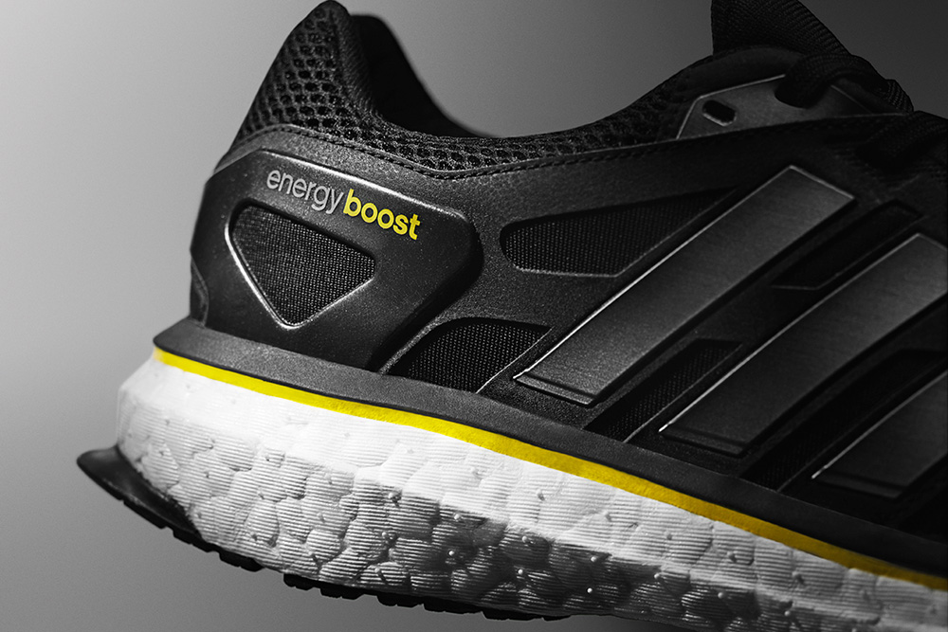
Torsion support system supports the vault and allows independent movement of the front and rear part of the foot; central framework maintains the position of the foot in place; external reinforcement for heel for better fit and comfort; adiWear durable rubber sole that reduces wear.

Slide 5
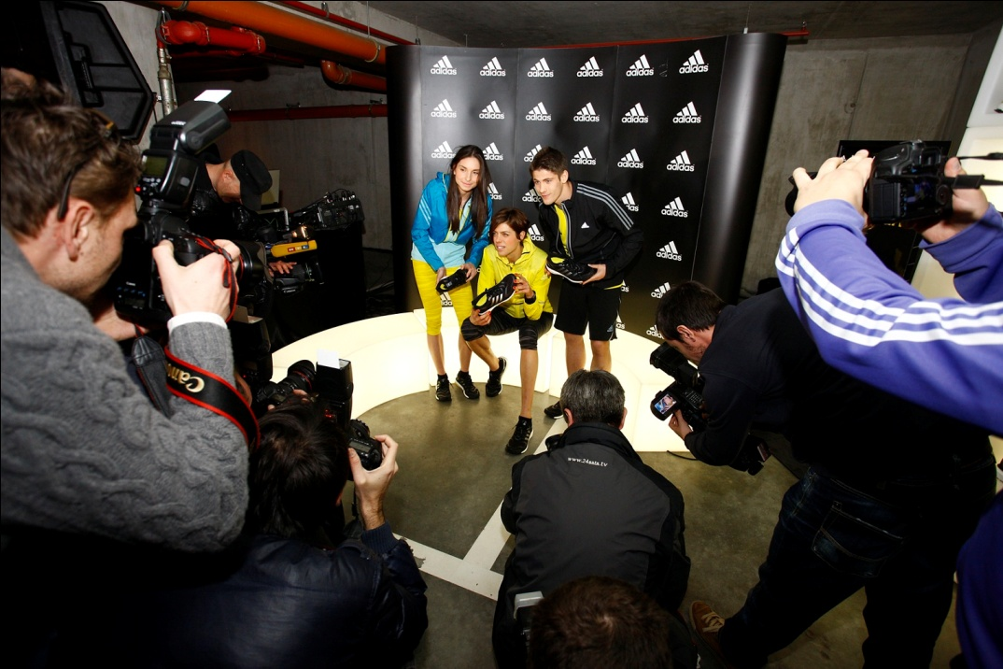
To test the Energy Boost sneakers were selected Blanka Vlašić,Matea Matosević multiple national champion in long-distance running and footballer Andrej Kramarić.

Slide 6
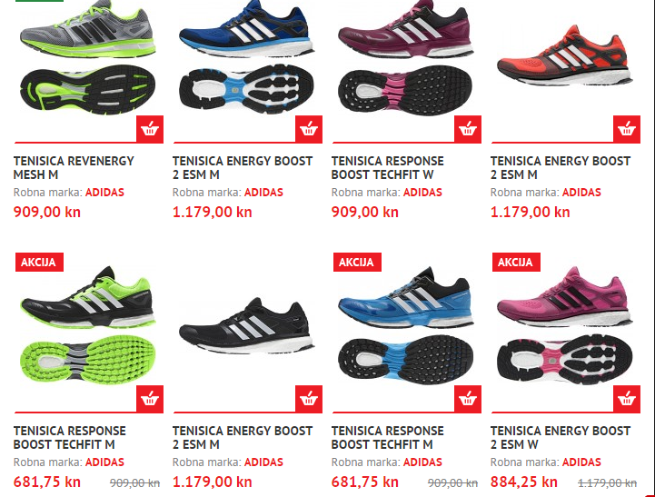
Buy Adidas Energy Boost in the sports shop Ferivi.Adidas Energy Boost are on sale. Supplies are limited, so as soon as possible buy these great shoes.

Slide 7
Presentation prepared:
Antonela Majstorić
Katarina Živković
Ana Berezovski
Aneta Kraljić,7.b ☺

