Slide 1
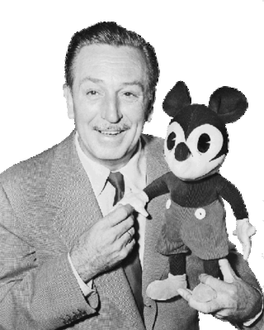
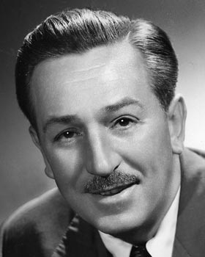

Slide 2
ABOUT WALTER
Walter Elias "Walt" Disney was an American animator, voice actor and film producer
He was born in Chicago in December 5, 1901

Slide 3
He was a heavy smoker in his life and he died of lung cancer in December 1966 in age of 65
He took art classes as a boy and got a job as a commercial illustrator at the age of 18
He moved to California in the early 1920s and set up the Disney Brothers Studio with his brother Roy

Slide 4
DISNEY’S ANIMATIONS
Walt developed the character Mickey Mouse in 1928, his first highly popular success

Slide 5
He made many animations such
as Snow White and the Seven Dwarfs (1937), Fantasia,Pinocchio (both1940), Dumbo (1941), Bambi (1942), Cinderella (1950) ...

Slide 6
HIS ACHIEVEMENTS
Disney holds the record for most Academy Awards
- He got 22 Oscars from 59 nominations. He was presented with two Golden Globe Special Achievement Awards and an Emmy Award, among other honors. Several of his films are included in the National Film Registry by the Library of Congress

Slide 7
THANKS FOR WATCHING
By Karlo Đaković

