Slide 1
Princess Diana Spencer

Slide 2
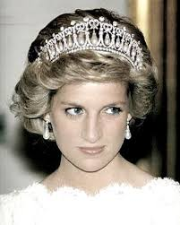
ABOUT
Diana Spencer was the first wife of British heir to the throne.
She was princess.
Her husband was Charles, Prince of Wales.
She was born on July 1,1961,and died August 31,1997.

Slide 3
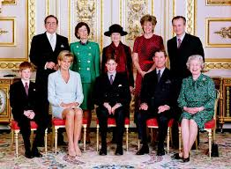
When she died she was only 36 years old.
Diana was also born in a not-so-famous family.
She had two sons, William and Henry.
They were also the Princes of Wales.

Slide 4
HER MARRIAGE
In 1980. Princess Diana wanted a divorce from Prince Charles.
They parted on 28 th August in 1996.

Slide 5
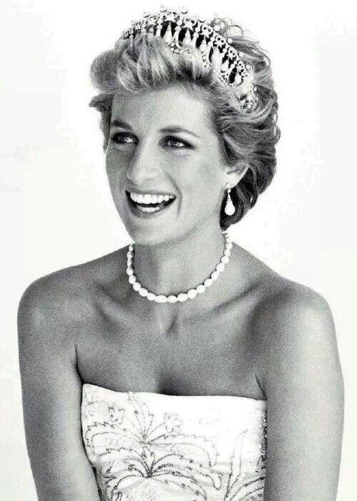
MORE..
In 1997 she received the Nobel Prize for assisting in mine clearance.
In August ,just a few days before her death , she visited Bosnia and Herzegovina.

Slide 6
HER DEATH
She died so what is its driver vehicle quickly to avoid the paparazzi . In the hospital was taken away only at 4 a.m.
Doctors have determined that Diana died so that the driver was drunk and that Diana was the victim usually planned accident.

Slide 7
Thanks for watching!!!
I hope you enjoyed.
by:Ema

